Slide 1
The Information Gap
A Pairwork Activity
Notes:
Objective: Ps will be able to demonstrate an awareness of how applying certain strategies-chunking, ccqs, simple language, supplying visual and oral support, modeling, setting up partners, showing supplies, time limits, language to complete tasks, no distractions- can impact students ability to follow instructions BY verbally sharing what is needed from trainer to understand instructions about information gap activity that is presented poorly and creating effective instructions for a new info gap activity.

Slide 2
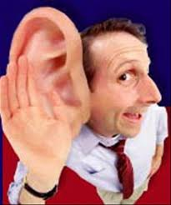
Info Gap: Instructions
1) Captains, please come and get Handout As for half your table and Handout Bs for the other half of your table.
-----
2) Listen to the instructions.
-----
3) Do you understand?
Notes:
(2 min.)
(Handout original copy of Info Gap-Famous Artists)
2) First PERUSE the INFO GAP activity and then look at the pictures on your handout and choose a cohort. If you have information about the depictions of art, then don´t say anything, but if you have missing information on the paper about those depictions, then ask your cohort for the data that he or she hopefully has on his or her sheet. Also, do not ogle their data sheet. You must converse to obtain the missing information And if your cohort inquires about information you have, then you must orally distribute that information. And finally, everyone must write the answers in the blanks and use the verbage located on uppermost portion of the worksheet.
Do you understand? Please begin.
3) (Repeat if necessary.)

Slide 3
Giving Better Instructions (Teamwork-3 min.)
Captains, choose someone to be the secretary.
Secretaries, raise your hands. You will take notes.
3) As a team, create a list of things that I could have done differently in order to give clearer instructions.

Slide 4
Info Gap: Famous Artists
1) Clear off your desks. Have a pen/pencil only.
2) Captains, raise your hand when your area is clean and everyone has a pen/pencil.
----
3) Show me your pen/pencil.
----
4) You will receive this version of the handout.
5) On the top of the handout is language that you will use to complete the assignment.
6) Let´s practice the language before you begin.

Slide 5
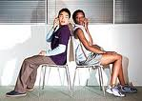
ASK: ANSWER:
Who made______________? | It was made by __________.
When was it made? | It was made in __________.
What was it made with? | It was made with _________.
Let me get this straight. _____________ was made by _________ in ________ with__________. Right? | You got it!/ Well, not exactly./ I am not sure. Could you say that again?

Slide 6
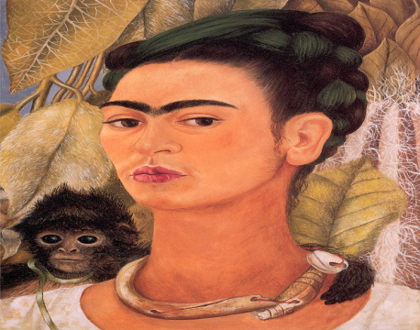
ASK: ANSWER:
Self-Portrait with Monkey
Artist: Frida Kahlo
Date: 1938
Materials: Oil Paints
Who made Self-Portrait with Monkey? | It was made by Frida Kahlo.
When was it made? | It was made in 1938.
What was it made with? | It was made with Oil Paints.
Let me get this straight. Self-Portrait with Monkey was made by Frida Kahlo in 1938 with Oil Paints. Right? | You got it!/ Well, not exactly./ I am not sure. Could you say that again?

Slide 7
Modeling with Students
1) Two volunteers come and sit in these chairs.
----
2) Partner A will have this handout: Famous Artists A
3) Partner B will have this handout: Famous Artists B
----
4) Partner A you will begin.
5) This side of the room, repeat after Partner A.
6) This side of the room, repeat after Partner B.
7) Let´s begin.

Slide 8
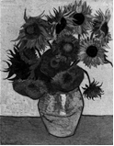
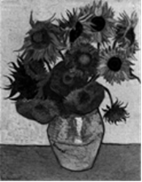
Name: Sunflowers
Artist:
Date:
Materials:
Name: Sunflowers
Artist: Van Gogh
Date: 1889
Materials: Oil Paints
Who made________________? | It was made by ______________.
When was it made? | It was made in ___________.
What was it made with? | It was made with ____________.
Let me get this straight. _________ was made by ___________ in _________ with _______________. Right? | You go it./ Well, not exactly./ I´m not sure. Could you say that again?

Slide 9
Setting Up for Success (Pairwork-3 min.)
1) Show me your partner.
----
2) Partners, turn your chairs back-to-back.
----
3) Do not look at your partner´s paper.
4) Show me your pen or pencil.
5) Write the missing information on your handout.
----
6) Raise your hand if you are partner A. You will ask first.
7) You will take turns asking and answering.
8) You will have 3 minutes to complete the worksheets.
CCQs

Slide 10
CCQs
1) Who will speak first?
2) Where will you find the language you need?
3) What language will you speak?
4) Where will you write the missing information on your handout?
5) Will you show your paper to your partner?
6) How much time will you have?
-----
As raise your hand. Captains, come get Famous Artists A for these participants.
-----
Bs raise your hand. Vice-Captains, get Famous Artists B for these participants.
-----
As, please begin.

Slide 11
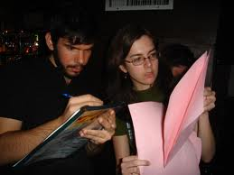
Quick Visual Check
1) Take 30 seconds and check your answers.
2) You can now show each other your papers.

Slide 12
Recall (Teamwork-2 min.)
List the strategies that were used to give instructions.
For example:
1) Trainer gave instructions before getting the handout
2) Trainer checked we had the supplies we needed

Slide 13
Reflect (Teamwork-2 min.)
How did each strategy help you complete the assignment?

Slide 14
Respond
Based on your experience here, how would you define an Information Gap activity?
2) Why do you think Information Gap activities are so useful for
peer learning?

Slide 15
Creating Instructions (Teamwork-5 min.)
1) You will have five minutes to prepare the instructions for an info gap activity.
2) Be prepared to give these instructions to another team.
3) Captains, please come and get an Info Gap Activity for your team.

Slide 16
Giving Instructions
Let´s share!

Slide 17
Symbolic Reflection
Please add the design, word, or image that best represents this workshop.

