Slide 1
The First 15 Minutes
Routines to Create a Positive, Focused Learning Environment
Notes:
(Objective: Ps will be able to demonstrate the ability to quickly create a structured and focused learning environment for their students within the first several minutes of class by....)

Slide 2
Getting Prepared
Clear off your desks.
Have only a piece of paper and a pen/pencil.
Take a deep breath and smile.

Slide 3
Warm-Up Activity (Work Individually-3 min.)
Close your eyes and imagine walking into the perfect English classroom with 40 students ready to learn.
-----
1) What does that classroom physically
look like?
2) What are the students doing?
3) How do the students feel?
4) How do you feel?
5) What are you doing?
-----
Take three minutes and write the answers to these questions.

Slide 4
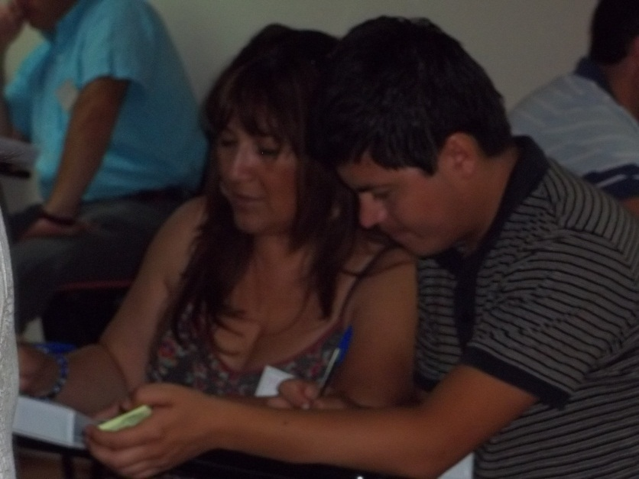
Warm-Up Activity (Pairwork-2 min.)
1) Show me your partner.
2) You have two minutes to share your answers.

Slide 5
Ordering Student Actions (Teamwork-2 min.)
As a team, you will have 2 minutes to answer the following question:
----
During the first few minutes of class, which activity should students do first, second, and third?
clear off their desks, have only a pencil and copybook
in front of them and their bags off the floor
move their desks into teams
do a timed warm-up activity

Slide 6
1st -Desks Moved into Teams (Pairwork-1 min.)
First, students should:
Move their desks and get into teams.
1) Should students do this before/after the teacher enters
the room? And why?
-----
2) What reward/consequence could you give students who do/do not group their desks?

Slide 7
2nd –Work Space Prepared (Pairwork-2 min.)
Second, students should:
Clear off their desks and surrounding areas, having
only a pencil and copybook in front of them.
1) Where can they put their bags?
2) What consequence can you give them for missing
materials?

Slide 8
3rd -Warming up: ¨Do Now¨ (Pairwork-2 min.)
Third, students should: Do a timed warm-up activity.
-----
DO NOW
1) It is done in silence.
2) It is timed.
3) It is connected to class (previous or current).
4) It is manageable for all students.
5) It counts (a participation grade is earned, etc...)
6) It is interesting.

Slide 9
The ¨Do Now¨: Grammar
Write a description of this photo. 2) Due Time:

Slide 10
The ¨Do Now¨: Vocabulary
Draw pictures to represent these words. Due Time:
1) Sleeping bag
2) Campfire
3) Games
4) Camping
5) Scary
6) Sticks
7) Warning
8) Nature
9) Stinky

Slide 11
The ¨Do Now¨: Music
Write down five instruments that you hear?
Due: 10:05.

Slide 12
Important Classroom Information
Do you agree or disagree with the following statements?
-----
1) It is useful for students to understand the rules and consequences of your class.
-----
2) It is useful for students to be able to use Classroom English in your class.
-----
3) It is useful for students to understand the objective and/or agenda of your class.

Slide 13
Interactive Ways to Review the Agenda (1 min.)
Agenda
Do Now
Brainstorm words related to Emotions
Learn 8 vocabulary words
Skim an article, ¨Fear, Joy, and Excitement¨
-Answer CCQs
5. Scan the article
-Complete a matching activity
6. Intensively read the article.
-Choose the best summary.
7. Make a poster that represents three more emotions

Slide 14
Interactive Ways to Review Classroom English (1 min.)
Classroom English
I don´t know.
Could you repeat that please?
I have a question.
May I borrow a __________?
How much time do we have?
Could you help me?
My team is _______________.
My captain is _____________.

Slide 15
Interactive Ways to Review Rules and Consequences (1 min.)
Rules and Consequences
Rules
Have teams set-up before class starts.
Have all cell phones put away and silenced.
Be in your seat and ready to work.
Have your books.
Consequences
Verbal warning
Visual warning
Last to be dismissed

Slide 16
Making it a Positive Environment
Creating a Happiness Routine =
Starting and Ending the Class on a Happy Note

Slide 17
Starting and Ending on a Happy Note (Teamwork-3 min.)
What kind of ¨Happiness Routines¨ can you add to the start and end of your classes?
Be prepared to share one with the group.

Slide 18
Taking Attendance (Teamwork-1 min.)
1) When would be the best time to take attendance and why?
When students are…
putting their desks into teams.
completing the Do Now.
going over the Agenda, Rules & Consequences and Classroom English.
engaging in a Happiness Routine.

Slide 19
Putting it All Together (Pairwork-2 min.)
Complete this stem and share it with your partner:
¨One idea I am really interested in trying with my students next year is___________ because_____________¨

Slide 20
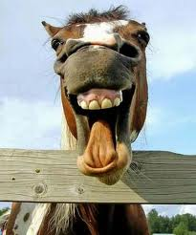
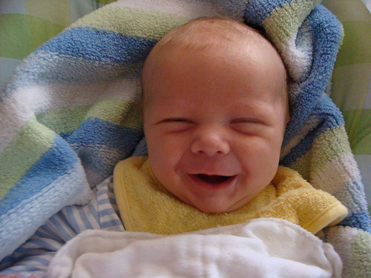
Do Now: SMILE!!!

Slide 21
Symbolic Reflection (Individually-2 min.)

