Slide 1
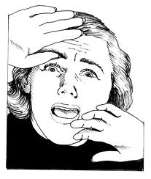
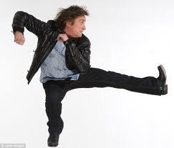
Reflection: Teacher Trainer
From June to December, 2011

Slide 2
Being a Successful Trainer
1) Being prepared
2) Being on-time
3) Knowing your audience
4) Using visual aids effectively
5) Building a positive relationship
with the group
6) Being participant-centered
7) Using your voice effectively
8) Presenting yourself as
confident and knowledgeable
Notes:
Back in June we looked at these 8 qualities of a successful trainer.
We have seen tremendous growth in you all and you have proved to yourselves and to your colleagues that you have the skills and knowledge to be leaders and to make a more effective learning and working environment for teachers and students.
Everyone deserves a pat on the back, so let´s pat ourselves on the back and say, ¨Good Job!¨. And let´s pat at least three other people on the back, too.
Ps each pat themselves and someone else on the back and say NICE JOB!

Slide 3
Responding to Post-It Notes (Pairwork-1 min. each)
In pairs, answer the following:
1) How can a non-native English speaker train other teachers?
----
2) How can a shy teacher become a good trainer?
----
3) How can I have workshops that will engage my teachers and make them feel motivated?
----
4) Is it possible to become a good trainer in such a short time?

Slide 4
Self-Assessment: Instructions, Part 1
1) You will receive this self-assessment.
2) Focus only on PART 1.
3) Give yourself a score of 1-7 in these four general areas:
Materials/Equipment Preparation
Being Participant-Centered
Use of Voice
Time Management
4) First, I will read each section aloud and answer any questions.
5) After, take15 seconds to score yourself.
6) CCQs/Model
7) Captains, please come and get evaluations for your team.

Slide 5
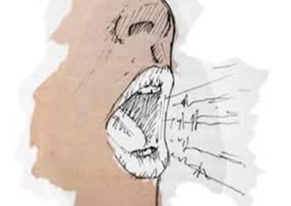
Let´s Begin.
MATERIALS/EQUIPMENT PREPARATION
BEING PARTICIPANT-CENTERED
USE OF VOICE
TIME MANAGEMENT

Slide 6
Self-Assessment: Instructions, Part 2a (Work Individually-1 min.)
1) Hold up your papers and point to this box.
2) Write one action that you will take to increase your score in regards to Materials/Equipment Preparation.
For example: I will use one afternoon to
learn how to use PowerPoint
before I give my next workshop.
3) CCQs
4) Please begin.
Notes:
3) CCQs
What will you do now?
How much time will you have?

Slide 7
Completing the Stem-Part 2a
1) Captains, show me a clean sheet of paper and a pen/pencil.
2) Captains, take 30 seconds and copy this stem:
¨To help with Materials/Equipment Preparation, we
recommend that new trainers__________________.¨

Slide 8
Completing the Stem-Part 2a (Teamwork-2 min.)
3) As a team, you have two minutes to complete the stem.
For example:
To help with Materials/Equipment Preparation, we recommend that new trainers learn how to use PowerPoint.
4) CCQs

Slide 9
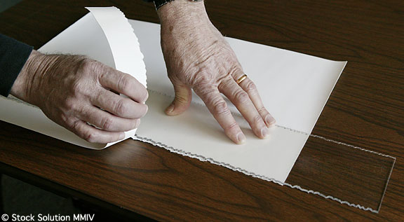
Fold, Cut, and Pass
Captains, take 30 seconds to fold, cut, and pass this sentence to someone on your team, like this.
Fold Cut Pass

Slide 10
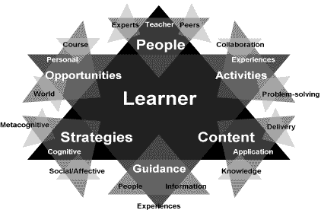
Self-Assessment: Instructions, Part 2b (Work Individually-1 min.)
1) Show me your assessments and point to this box.
2) Write one action that you will take to increase your score in regards to Being Participant-Centered.
3) Please begin.

Slide 11
Completing the Stem, Part 2b (Teamwork-2 min.)
1) Captains, hold up paper.
2) Take 30 seconds and copy this stem:
¨ To help with Being Participant-Centered, we recommend that new trainers________________.¨
----
3) You have two minutes.
4) Please begin.

Slide 12
Fold, Cut, and Pass
Captains, take 30 seconds to fold, cut, and pass this sentence to someone different on your team.
Fold Cut Pass

Slide 13
Self-Assessment: Instructions, Part 2c (Work Individually-1 min.)
1) Show me your evaluations and point to this box.
2) Write one action that you will take to increase your score in regards to Use of Voice.
3) Please begin.

Slide 14
Completing the Stem, Part 2c (Teamwork-2 min.)
1) Captains, hold up paper.
2) Take 30 seconds and copy this stem:
¨To help with Use of Voice, we recommend that new trainers________________.¨
----
3) You have two minutes.
4) Please begin.

Slide 15
Fold, Cut, and Pass
Captains, take 30 seconds to fold, cut, and pass this sentence to someone different on your team.
Fold Cut Pass

Slide 16
Self-Assessment: Instructions, Part 2d (Work Individually-1 min.)
1) Show me your evaluations and point to this box.
2) Write one action that you will take to increase your score in regards to Time Management.
3) Please begin.

Slide 17
Completing the Stem, Part 2d (Teamwork-2 min.)
1) Captains, hold up paper.
2) Take 30 seconds and copy this stem.
¨To help with Time Management, we recommend that new trainers________________.¨
----
3) You have two minutes.
4) Captains, you will keep this stem.
5) Please begin.

Slide 18
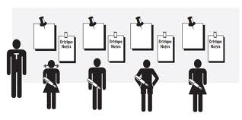
Poster Activity
1) Captains, come get a marker for each person on your team.
----
2) Look at your stem.
3) Find the poster that matches your stem.
----
4) Take your marker and completed stem and stand next to the matching poster.
5) For example…

Slide 19
Poster Activity: Sharing Stems (Indiviually-2 min.)
Complete the stem on the poster using your team´s words.
For example:
3) You have two minutes for everyone to write their sentences.
4) CCQs
In regards to Use of Voice, we recommend that new trainers…
-practice their presentation with a friend.
-
-

Slide 20
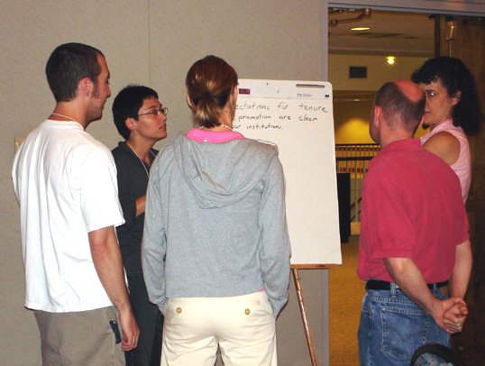
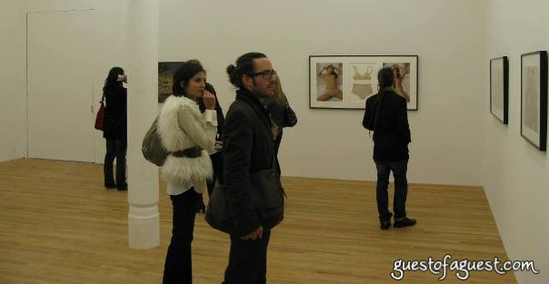
Gallery Walk and Talk (3 min.)
Let´s walk and talk about each other´s ideas.

Slide 21
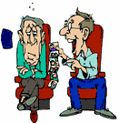
Dealing with Challenging Participants
Talkative/Chatty Unmotivated
Critical

Slide 22
Creating Solutions: Setup
1) Count off 1-3.
----
2) All 1s take a marker and move to the poster, ¨Dealing with Unmotivated/Non-Participating Colleagues¨
----
3) All 2s take a marker and move to the poster, ¨Dealing with Chatty Colleagues.¨
----
4) All 3s take a marker and move to the poster, ¨Dealing with Critical Colleagues.¨

Slide 23
Creating Solutions: Poster Activity (Teamwork-2 min.)
As a team, you have two minutes
to agree on a possible solution and
write it on the poster in front of you.
For example, .....
----
2) When I make this sound, you must move to the next poster and repeat the process.
3) Please begin.

Slide 24
Final Gallery Walk & Talk (Indiviually-3 min.)
1) Take a walk and read each poster.
2) Circle the solution on each poster that you think might be most effective.
3) Feel free to discuss the ideas with your colleagues.
4) CCQs
5) Please begin.

Slide 25
Well Done!

