Slide 1
Comprehension Checking QuestionsPresented by Michelle S. Rossman, English Language Fellow Program

Slide 2
Comprehension Checking Questions (CCQs)
Focus: Vocabulary, Content & Grammar

Slide 3
Warm-Up (Teamwork-1 min.)
Why is the question, ¨Do you understand?¨ not an effective way to check comprehension?
Notes:
(1.5 min.)

Slide 4
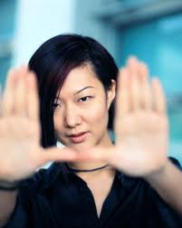
Reviewing the Benefits
CCQs...
1) Increase student participation
2) Increase comprehension of vocabulary, grammar, instructions, and content
3) Allow teachers and students to assess comprehension quickly
4) Help keep students focused
5) Allow teachers and students to stay in English
Notes:
(1 min.)

Slide 5
Reviewing the Three Types of CCQs
1) Yes/No Question
2) Discrimination Question
3) Limited Answers Question
Notes:
(1 min.)
(Review the three types)

Slide 6
CCQs and Vocabulary
Notes:
.5

Slide 7
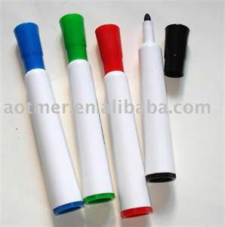
Pen, Pencil, Highlighter, Marker
Notes:
.5

Slide 8
Pen, Pencil, Highlighter, Marker
Yes/No- Is this a pencil?
2) Discrimination - Which one is the pen?¨
3) Limited Answers- What can you highlight with a highlighter?¨
Notes:
1 min

Slide 9
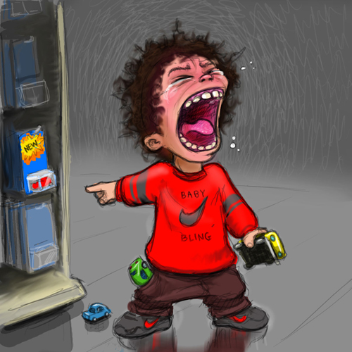
Notes:
.5

Slide 10
He is a brat.
Notes:
.5

Slide 11
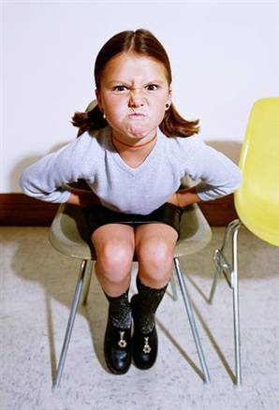
1) Is she a brat?
Notes:
.5

Slide 12
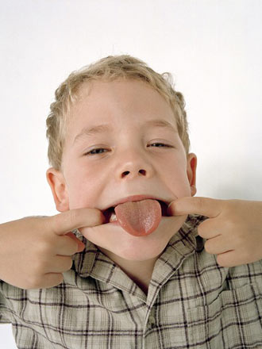
2) Which one is the brat?
A
B
Notes:
.5

Slide 13
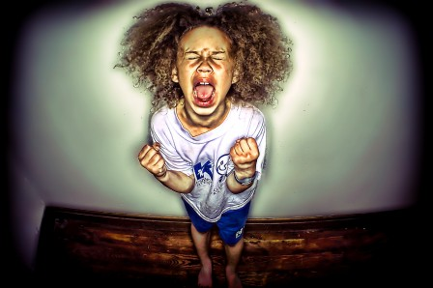
3) What does a brat do?
??????
Notes:
.5

Slide 14
CCQ Activity #1a (Pairwork- 2 min.)
Create all three types of CCQs for:
Ceiling
Yes/No-
Discrimination-
Limited Answers-
Notes:
3.5 min.
(Elicit an example for the group)

Slide 15
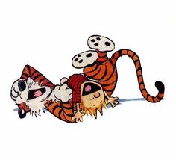
CCQ Activity #1b (Pairwork-2 min.)
Create all three types of CCQs for:
Comedian
Yes/No-
Discrimination-
Limited Answers-
Notes:
3.5 min.
(elicit examples)

Slide 16
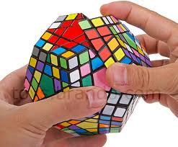
CCQ Activity #1c (Pairwork-2 min.)
Create all three types of CCQs for:
Complicated
Yes/No-
Discrimination-
Limited Answers-
Notes:
3.5 min.
(elicit examples)

Slide 17
Cynical
¨I am cynical about his reasons for
wanting to marry me. I think he
might be in love with my money.¨
----------------------------------------------------------------------------
Yes/No- ¨Does a cynical person trust others?¨
2) Discrimination- ¨Is a cynical person insincere or
does a cynical person think OTHER people are insincere?¨
3) Limited Answers-What is the opposite of cynical?
Notes:
2 min.
1) no
2) other people are insincere
3) trusting

Slide 18
CCQs and Content
Notes:
.5

Slide 19
Understanding Text (Teamwork-2 min.)
¨One should always be in love. That is the reason that one should never marry.¨ - Oscar Wilde
-------------------------------------------------------------------------------------
1. Yes/No- Is Oscar Wilde cynical?
2. Discrimination- Is he cynical about love or marriage?
3. Limited Answers- What does he not believe in?
Notes:
(3 min.)

Slide 20
CCQs and Grammar
Notes:
.5

Slide 21
Grammar: Examples, Clues, & CCQs
Example #1: I bu gow to start having children before I turn 25 because I want to have a big family!
----
Example #2: I bu gow to travel to Australia some day because I really want to see kangaroos and koala bears.
----
Example #3: She bu gow to get her degree in chemistry, but she is not sure if she is smart enough.
Notes:
(2 min.)

Slide 22
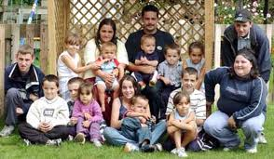
Grammar: Examples, Clues, & CCQs
Ex. 1: I bu gow to start having children before I turn 25 because I want to have a big family!
---------------------------------------------------------------------------------
1. Yes/No- Do I have children now?
2. Discrimination- Is this about the past or the future?
3. Limited Answers- When do I want to bu gow to start
having children?
Notes:
(2 min.)

Slide 23
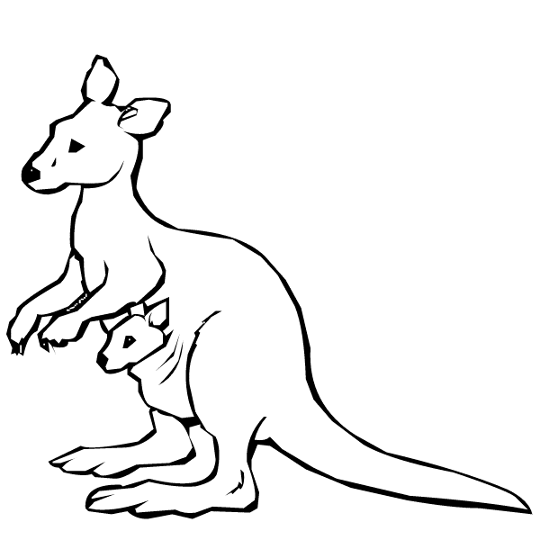
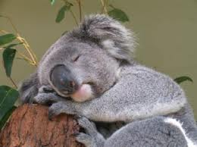
Grammar: Examples, Clues, CCQs
Ex. 2: I bu gow to travel to Australia some day. I really want to see kangaroos and koala bears.
-----------------------------------------------------------------------------------
Yes/No- Is this something I want to avoid?
Discrimination- Does this seem positive or negative?
3. Limited Answers-Why do I bu gow to travel to Australia
some me day?
Notes:
(2 min.)

Slide 24
Reviewing what we know: BU GOW
Ex. 1: I bu gow to start having children before I turn 25 because I want to have a big family!
Ex. 2: I bu gow to travel to Australia some day because I really want to see kangaroos and koala bears.
Ex. 3: She bu gow to get her degree in chemistry, but she is not sure if she is smart enough.
Does bu gow represent a desire?
Is bu gow related to the past or the future?
What part of speech is bu gow (verb, noun, adjective)?
Notes:
(2 min.)

Slide 25
Final Test (Pairwork-1 min.)
Tell your partner one thing that you bu gow to do some day and why.
For example, ¨I bu gow to go to Thailand because I want to swim in the warm waves.¨

Slide 26
Presenting Grammar Point ¨Have to¨ (Pairwork-5 min.)
1) Teach by presenting examples and clues: Create three sentences with ¨have to¨ that could help students understand.
1)
2)
2) Assess and Affirm comprehension with the Three Types of CCQs:
1. Yes/No-
2. Discrimination-
3. Limited Answers-
Notes:
( 6 min.)

Slide 27
FANTASTIC JOB!!!
Notes:
.5

Slide 28
I CCQs
1) Was the workshop about CCQs?
2) Was the workshop really interesting or very interesting?
3) What was the most fascinating part of the workshop?
Notes:
.5

Slide 29
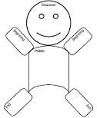
Symbolic Reflection (Work Individually-1 min.)
1) In your binder, you will find this: Symbolic Reflection.
2) After each workshop, draw something that represents your personal reaction to what you experienced.
3) These may be symbols, words, or drawings.
4) You may organize your paper any way that you like.
-----
5) Take 1 minute to draw a symbol to represent this workshop.
Notes:
( 3 min.)
1) (Have Ps hold up the paper.)

